Slide 1

Best practices for code testing
Jane Voytik
Bioinformatics JC, 15.12.2021

Slide 2

Why test?
Find bugs
Add new features with high confidence (test-driven development)
Refactor the code with high confidence
Notes:
https://image.shutterstock.com/image-illustration/bad-green-bug-260nw-78654769.jpg

Slide 3
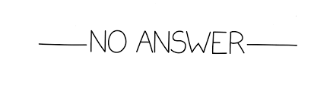
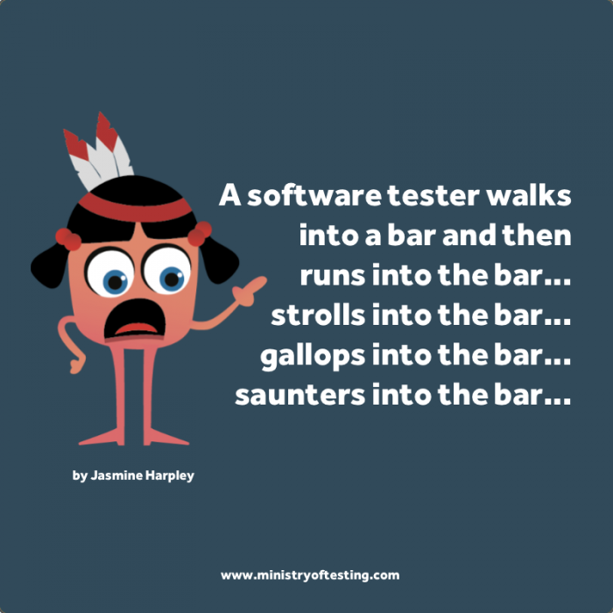

How many tests should one write for one function?
Test for these argument type:
Bad arguments
Special arguments
Normal arguments
Notes:
https://image.shutterstock.com/image-illustration/bad-green-bug-260nw-78654769.jpg

Slide 4
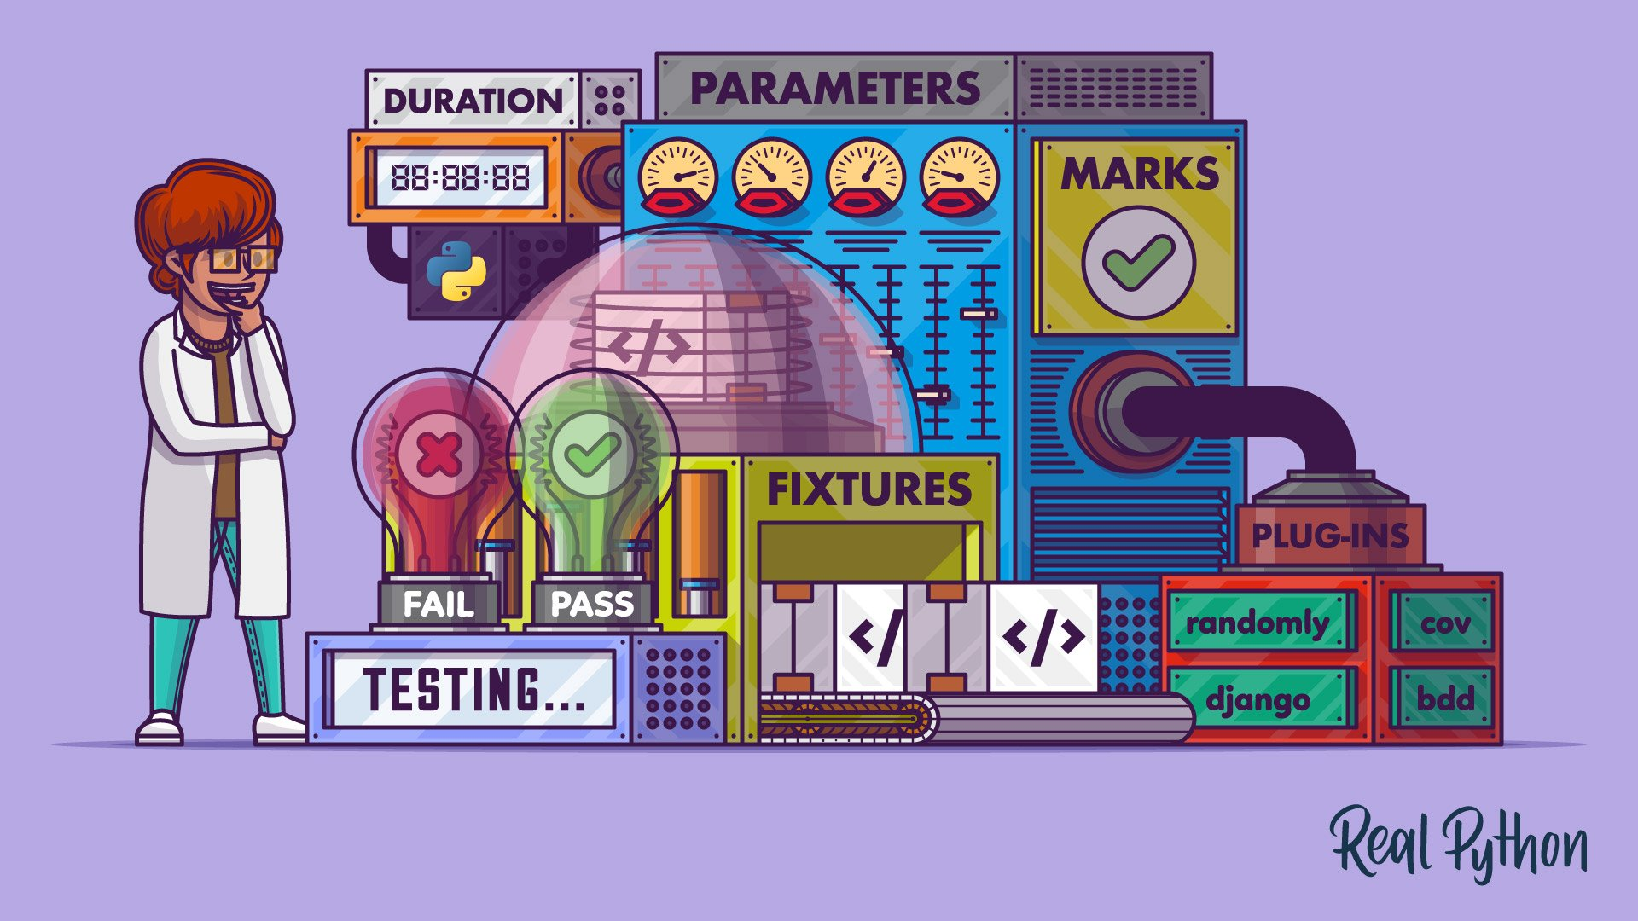
Advantages of pytest compared to other libraries?
Easy to get started
Run the test that you want
Powerful features / a lot of plugins
https://realpython.com/pytest-python-testing/
Notes:
https://c.neh.tw/thumb/f/720/0032983a681f48a88dc3.jpg
pytest is a feature-rich, plugin-based ecosystem for testing your Python code.
Most functional tests follow the Arrange-Act-Assert model:
Arrange, or set up, the conditions for the test
Act by calling some function or method
Assert that some end condition is true

Slide 5

pytest vs. unittest
# test_with_unittest.py
from unittest import TestCase
class TryTesting(TestCase):
def test_always_passes(self):
self.assertTrue(True)
def test_always_fails(self): self.assertTrue(False)
# test_with_pytest.py
def test_always_passes():
assert True
def test_always_fails():
assert False
Notes:
That’s it. You don’t have to deal with any imports or classes. Because you can use the assert keyword, you don’t need to learn or remember all the different self.assert* methods in unittest, either. If you can write an expression that you expect to evaluate to True, then pytest will test it for you.

Slide 6
Pytest feature: fixtures
Advantages of fixtures:
Modularity
Scope: per each function, per module, per session
Parameterize your tests
Notes:
Functions that pytest runs for you before running any tests

Slide 7
Pytest plugin: running tests in parallel
xdist:
pip install pytest-xdist
Specify how many tests to run in parallel:
pytest -n OR pytest -n auto
https://pypi.org/project/pytest-xdist/
Notes:
https://image.shutterstock.com/image-illustration/bad-green-bug-260nw-78654769.jpg
Pass -n auto to use as many processes as your computer has CPU cores.

Slide 8



Other useful Pytest plugins
ipytest:
It provided a support for pytest inside notebooks.
pytest-randomly:
It forces your tests to run in a random order.
pytest-cov:
It measure how well your tests cover your code.
https://docs.pytest.org/en/latest/reference/plugin_list.html
Notes:
https://image.shutterstock.com/image-illustration/bad-green-bug-260nw-78654769.jpg
This is a great way to uncover tests that depend on running in a specific order, which means they have a stateful dependency on some other test. If you built your test suite from scratch in pytest, then this isn’t very likely. It’s more likely to happen in test suites that you migrate to pytest.

Slide 9
Test discovery
Name your modules test_*.py
Inside each .py file create functions called test_{functions}
Run just one module:
pytest test_*.py
Run several files using regex:
pytest –k “quick or raw”
Other markers: https://docs.pytest.org/en/latest/example/markers.html#using-k-expr-to-select-tests-based-on-their-name
Notes:
https://image.shutterstock.com/image-illustration/bad-green-bug-260nw-78654769.jpg

